Slide 1
Fruit Winemaking
Overcoming Fruit Wine
Production Issues
By: Dominic Rivard – WinePlanet Consulting

Slide 2
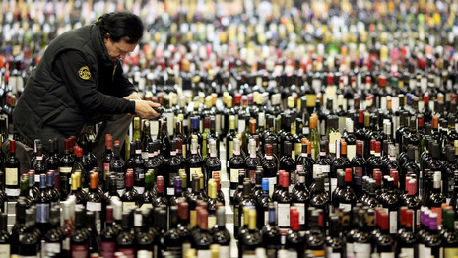
Challenges and Solutions
Production Issues
Specific to Fruit Wines
Notes:
There are challenges with fruit wines, however they can be overcome with some focus.

Slide 3
From a ‘good’ wine to ‘GREAT’ wine
Making a drinkable wine – not a big deal
Making a GREAT wine – more to it
Similar principles to raising a child
Be ready to: Encourage, Protect, Correct, Sometimes Punish, Inspire and Direct.
Goal is to prevent faults, enhance what you have and turn your fruit into the very best it can be.
Notes:
Making a drinkable wine is not very complicated. There is a lot of good information out them that tell you how. Making a world-class, multiple award wining wine takes a lot more than following a recipe. It involved being able to identify and correct issues and a lot of problem solving, early, before they are bigger problems. There is often a lot of intuition and gut feeling that can come into play. Experience helps and understanding your fruit, how it reacts to turning itself into wine and all outside influences that can prevent it from becoming the best it can be. You are like a parent raising a child. If you love your child (wine), you have a vision of what you would like your child to become and achieve his or her potential. Your job is to give that fruit the best possible chance to achieve the best it can be and be ready to encourage, protect, correct, sometimes punish, inspire, and direct to achieve all it can be, which is to be world-class fruit wine that can be enjoyed by the widest consumer base as possible.

Slide 4
Dealing with unruly wine
Issues that happen in fruit wine, how to prevent them (ideal) or overcome them when they do occur.

Slide 5
Colour dropping – Colour stability
Improper enzyme use Improper fining use
Fermenting too warm Oxidation of delicate fruit
Improper KMS use Use tannins!
Use inactivated yeast Use frozen fruit – better extraction

Slide 6
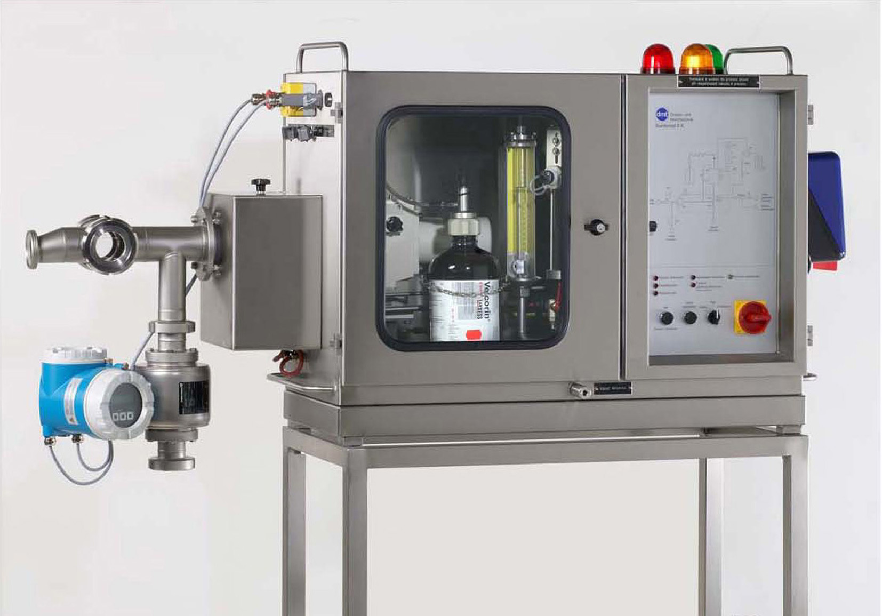
Preventing Refermentation - using preservatives -
Proper cleaning and sanitation
Proper FSO2 levels – aim for a 0.8ml/L Molecular SO2 level
Sorbate Levels – two schools of thought, aim for 180-220ppm
Proper sterile filtration techniques
Don’t bottle in same room while other wines are actively fermenting
Pasteurization - PU units – too little, no effect, too much, degradation of flavors.
Velcorin – can be useful in lower alcoholic, sweeter wines. Effective but an expensive set up – could forgo sterile filtration if used

Slide 7
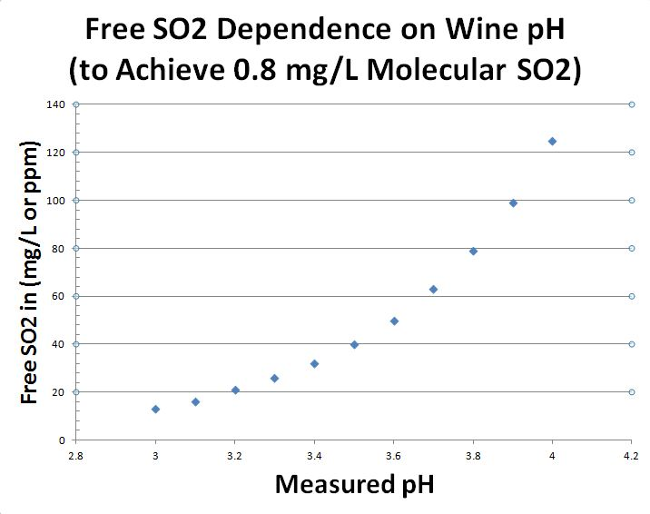

Slide 8
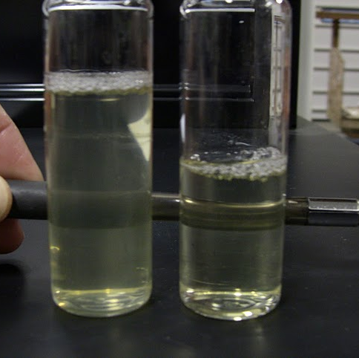
Stability – Hazes
Colored Haze – caused by use of certain metals vessels and instruments – citric acid
Darkening juice – caused by oxidation or enzymic action – stablelize with SO2 and start the fermentation asap
Pectin Haze – Most common – test with pure alcohol – treat with pectic enzyme
Lactic Haze – Caused by MLF – silky sheen to wine. Treat with So2 and filter.
Starch Haze – Caused by boiling/heating fruit or too hard pressing. Test with iodine (5 drops in 8oz = indigo blue) Treat with amylase

Slide 9
Hard to Start Ferments – Stuck Ferments
Caused by:
Lack of nutrients (improper YAN level)
Very low pH level
Dramatic change in temperature disagreeable to the yeast.
Prone to hard to start or stuck ferments:
Blueberry wine – low pH and low TA
High gravity juices – cryo-extracted juices
Use the right yeast strain! Don’t skimp on nutrient!

Slide 10
Oxalic & Ellagic Acid Deposits
Common fruit wine instabilities (especially in berry fruit):
Oxalic Acid Deposits – Crystalline filaments common in raspberry/blackberry wine, rhubarb wines. Some soils are more prone to producing fruits with this issue than others. Add 0.33g/L citric acid to help prevent. Don’t bottle too quickly.
Ellagic Acid Deposit – Often for oak ageing/wood treatment. Fruit wines from strawberries and loganberry can show ellagic acid instability even without wood treatment. These fruits have a naturally high content of ellagitannins, which will hydrolyse in the finished fruit wine giving an ellagic acid deposit. Don’t bottle too quickly! Wait at least 4 weeks after final filtration before bottling.

Slide 11
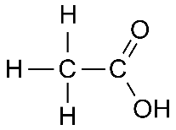
High VA in Cryo-Extracted Wines
The bane of ice wines and cryo-extracted fruit wines
Very high sugar can be toxic to some yeasts
Fermentation of very high brix juices often exceeds legal VA levels
Use:
Yeast that work well in high brix environments (R2, EC1118, etc)
Use yeast with low VA production potential
Adequate level of rehydration aid such as Go-Ferm Protect
Follow proper YAN level protocols, limit yeast stress as much as possible

Slide 12
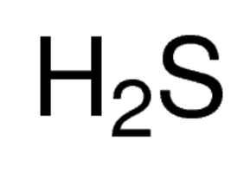
H2S with Heavy Lees Wines
Many fruit wines are prone to H2S issues due to many factors, including juices and wines with heavy solid levels.
Distinctive rotten egg/burnt-rubber aroma can develop quickly in some juices and wines such as strawberry, blueberry, haskap berry and elderberry.
Causes:
Too much sulfites
Lack of proper nutrients
Bacterial contamination
Leaving juice on sediment too long, not racking at proper time
Treatment: Do it before H2S turns worst to marcaptans!
Splash racking
Start the ferment ASAP
Copper Sulphate (0.5ppm MAX!)

Slide 13
High TA/Low pH wines
Some fruits are notorious for being hard to adjust because of the initial acid balance.
Cranberry and black currant wines: low ph/high TA – balance of acid/flavour dilution and potassium carbonate use.
Blueberry has very low pH and low TA – hard to adjust for initial ferment – adjust the pH, start the ferment and adjust the TA post ferment.
Passion Fruit wine – an extreme example! Lingering metallic acid finish which is hard to remove.

Slide 14
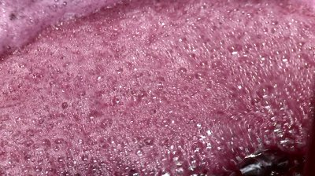
Way Too Quick Ferments
Not having a good control of the ferments can cause burning off fruit of flavors on high pH fruit.
It can render apple, pear, pear wines flavorless and berry wines insipid and boring.
Temperature control – use a glycol chiller!
If not available, use a slower ferment speed yeasts (71B)
If possible, avoid the use of DAP – like giving candy to a child, use inactive yeast instead for nutrient.

Slide 15
Yeasts to use in Fruit wine
Lallemand 71B – all around yeast for most off dry wines. Really helps bring out the fresh fruitiness in most berry and some tree fruit wines.
Lallemand BA11 – excellent on tree fruit and tropical fruit wines. Boosts aroma and can increase “mouth feel”.
Lallemand EC1118 – good all around yeast to use, especially with wines with low pH or starting the ferment at low temperatures. Wines that need to ferment to a very dry level, or to make a sparkling wine, this is the yeast to use.
Lallemand K1 – brings out freshness in tree fruit wines such as apple, peach or peach. Will ferment well, no matter what the pH or temperature of the must is.
Lallemand R2 – A strong strain, ideal for very sweet fruit wines, cryo-extrated wines and wines that need to ferment at low temperatures and retain the aromatic qualities. I use this yeast in “iced” fruit wines with a lot of success.
Lallemand VIN13 – Use this yeast in wines that need higher alcohol without fortification as it can ferment to almost 17% without any help. It gives me good tropical notes and relatively clear flavors and can ferment under cooler temperatures.
Bio Springer CKS 102 – Use to make aromatic berry wines such as raspberry or delicate strawberry wines. Also works great on tropical wines such as lychee, pineapple and passion fruit. In fruit wines, we want as “clean” a ferment as possible and this strain does a good job at it.
Oenoferm Freddo – Brings out fresh fruit aroma.

Slide 16
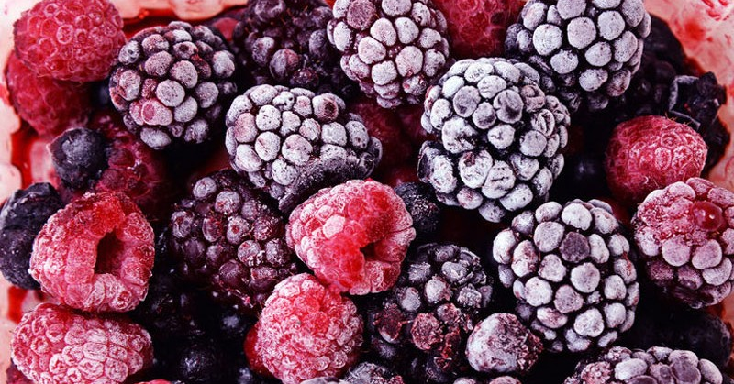
Working with frozen fruit
Do NOT try pressing fruit that is still partially frozen!
Can’t get proper enzyme extraction until the fruit reaches room temperature
Frozen fruit in insulated bins takes FOREVER to thaw
Freeze in 5 gallon pails if possible. More efficient and easier to handle.
With a very slow thaw, fibrous structure of fruit breaks down and is harder to press. Use pressing aids (rice hauls).
Getting proper enzyme extraction before pressing at the right temperature is critical. Needs extra planning on the process when using frozen fruit.

Slide 17
Crushing/Pressing issues
Getting the perfect equipment for each fruit is often not possible.
Most lower cost presses are designed for grapes.
Specific fruit presses are designed for large production – unaffordable for most.
Get the best between cost/variety of fruit to process and yield.
Depitting stone fruits before pressing – peaches, cherries
Pressing low fibrous fruit like strawberries/raspberries – use pressing aids!
My favorite fruit press = a screw press!

Slide 18
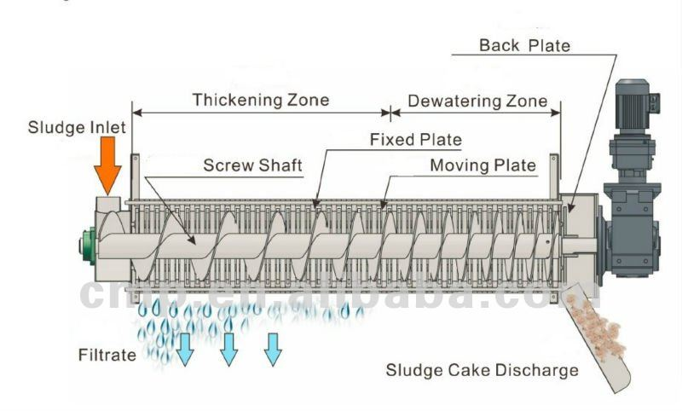

Slide 19
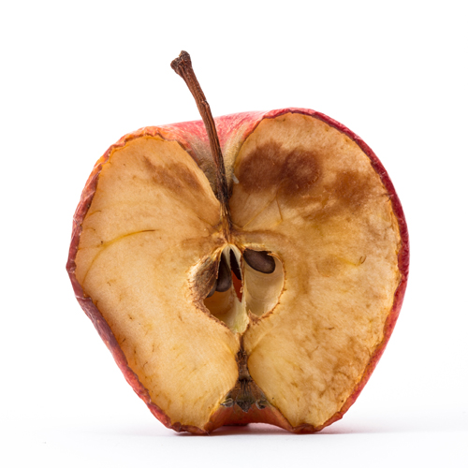
Quick Oxidation of Fruits
Some fruits are more prone to oxidation than others due to low tannic content and higher pH. Needs special attention.
Prone: Apple, strawberry, pear, peach
Keep in mind:
Add tannins to fruit wines – provides structure and lowers oxidation potential
Don’t be afraid of SO2 –use it pre and post ferment at the proper level
Use of N2 in tanks with is air space exists in tanks
Start the ferments as soon as possible.
Use of ascorbic acid can be helpful

Slide 20
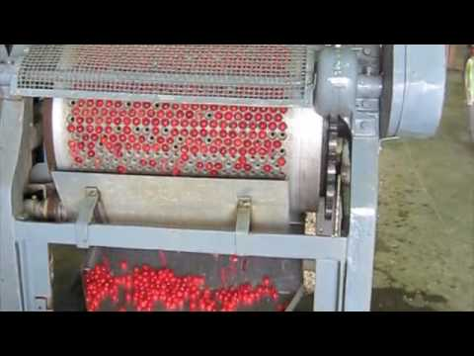
Dealing with Seeds/Pits & Bitterness
Peaches – wait until ripe to remove pit
Not de-pitting is playing with fire
Alcohol breaks down pits and causes off flavors and unwanted bitterness – more serious in blueberry and strawberry
Pressing fruit with pits can release harsh bitterness. Low yields.
If some pits get through and there is bitterness from them, lower it with gelatine fining.

Slide 21
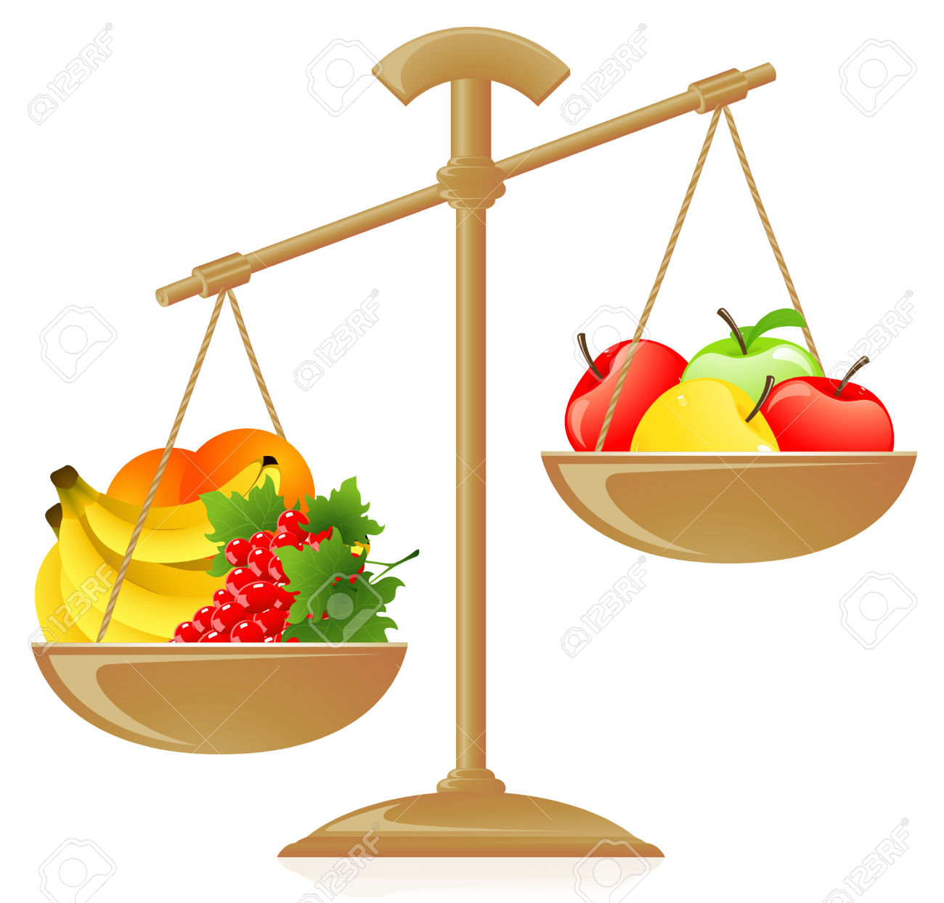
Dilution Ratios – Balancing Act
Most berry wines need to be diluted to balance flavor intensity and acid.
Finding that sweet spot for the style you are aiming for is the key.
The dilution ratio is directly correlated to the wine style and the fruit used.
Cranberry: 30% ratio (rest can be water or low acid apple juice)
Currants/Raspberry: 25-50% depending on style
Haskap/Sour Cherry: 40% ratio
Apricot: 60-90% ratio
Apple, pear, peach: Single strength juice

Slide 22
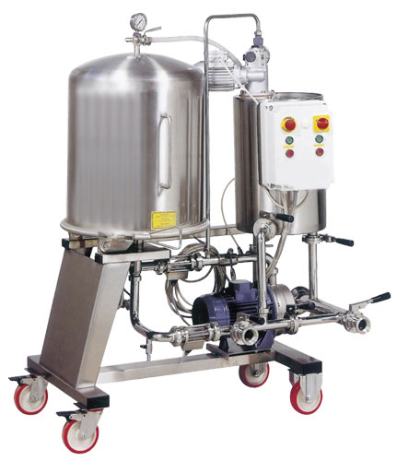
Filtration issues
Fruit wines can be more difficult to filter than other wines if:
Not enzymed properly – especially apricot
Pressing did not go as planned – heavy solids/puree
Trapped gases in the wine prior to filtration – rack
Improper rates of finings used
Keep in mind:
Chill down wine during fining stage
Don’t filter unless well fined – conduct fining trials first
Start with a DE filter or rough pads (T1500)

Slide 23
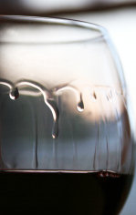
Low body wines - Increasing Wine Structure
Using slightly under ripe fruit can create wines that need extra help.
Some wines can be improved by increasing structure, complexity and mouthfeel.
Use tannins pre ferment and post ferment
Post ferment enzymes such as “BG” increase fruit aroma
Adding Arabic gum prior to bottling increases mouthfeel
Adding glycerine to increase mouthfeel (3-5ml/L)
Some blending can also help

Slide 24
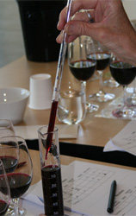
Fruit Wine Blends
Blending is where a “good” wine can help make a “great” wine if blended in the right proportion and with the right “partner”.
Two clashing personalities do not always make a great relationship; the same can be said with wine.
Like a partnership, need two compatible people to make a great couple. The ideal scenario of compabillity is when one’s strength complements the other’s weakness and vice versa. Blend a low acid wine with a high acid wine, or a strongly flavored wine with a more neutral wine.
Used to tweak, soften, acidify, tone down, build up, etc
What works:
Cranberry – Apple Saskatoon – Strawberry Strawberry – Rhubarb Raspberry – Pear Passion Fruit – Apple

Slide 25
Getting to the next level
Important: What wine judges are looking for in your wines
Way More Important: What wine consumers are looking for in your wine

Slide 26
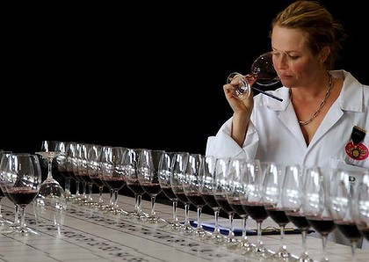
What Wine Judges are Looking for
Are you making a fruit wine or a “Wannabe” grape wine?
Appearance – vibrant and clear?
Nose – most important factor in determining wine quality
Taste – complex, mouthfeel, true to the fruit
Finish – long and lingering or short? Off-flavors? After Taste?
Overall impression and how it compares to the wines made by your peers.
Notes:
I have judges wines at formal wine competitions in 7 countries and 3 continents and wine judges are all the same, they are all looking for the same thing and if your goal is to achieve awards that can be used for promotional and marketing purposes (and to boost your egos) you will want to have the following in mind in the winemaking process.

Slide 27
What wine consumers are looking for
Balance is key!
Is the wine an enhanced and clear expression of the fruit stated on the label?
Does the wine look brilliant, clear and healthy?
Does the wine have a clean, vibrant and natural aroma?
Does the wine provide the drinker an enhanced experience?
Is the wine so good that the drinker will want to buy this wine again and tell their friends about it?
Have the above in mind when planning production.

Slide 28
Questions?
dominic@wineplanet.ca

