Slide 1
Sound Wine Production
Essential Analysis
Avoiding Faults
January 17, 2025

Slide 2
Production
Lab Analysis
Cleaning and Sanitation
Fruit Quality
Fermentation Management
Racking and filtration
Fining and Blending
Bottling Procedures

Slide 3
The Winery Laboratory
Building considerations
Easily accessible from all processing areas
Minimum 100 sq. feet
Sink
Sturdy table or counter
Chemical storage
Good ventilation
Refrigerator

Slide 4
Lab Equipment
Necessities:
Refractometer/hydrometers
pH meter
Titration set-up (burette, burette stand)
Ebulliometer
Analytical balance
SO₂ measurement
Several thermometers
Asst. glassware (beakers, flasks, etc.)
Others
Volatile acidity still, nephelometer, carbodoseur, spectrophotometer, others

Slide 5
The Winery Laboratory
Flow chart establishes:
Place of each analysis in the production scheme
Time that results of each analysis are needed
Level of accuracy and specificity for results
Acceptable ranges for results
Allows the winemaker to formulate a proactive course of action if results fall outside of specified range.

Slide 6
Analysis Flow Chart
From: Zoecklein, B.
Enology Notes #115

Slide 7
Harvest | pH | Ta | Brix | Nitrogen | Sensory | Temperature
During Fermentation | Residual sugar | MLF | Sensory |  |  | Y
Post-fermentation | pH | Ta | Free SO2 | Sensory |  | Y
Post- cold stabilization | pH | Ta | Free SO2 | Alcohol | Sensory | Y
Trouble shooting | VA | Fining trials | Aroma Screen | Stability tests | Sensory | Y
Post adjustment | pH | Ta | Free SO2 | Alcohol | Sensory | Y
Pre-bottling | Free SO2 | Sensory |  |  |  | Y

Slide 8
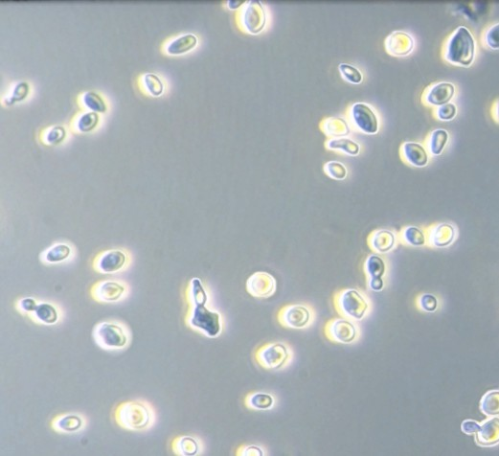
Faults
Analysis
Oxidation
Sulfur Compounds
Spoilage yeasts
Cork taint
Geranium taint
LAB
Harvest
Brix
pH
Titratable Acidity (TA)
Post Fermentation
Alcohol, pH, TA, Free SO2
Residual Sugar
Heat Stability, Cold Stability
Organoleptic assessment

Slide 9
“ It’s not what you look at that matters, it’s what you see.”
H D Thoreau
“ Knowledge is knowing a tomato is a vegetable, Wisdom is knowing not to put it in a fruit salad.”
Brian O’Driscoll

Slide 10
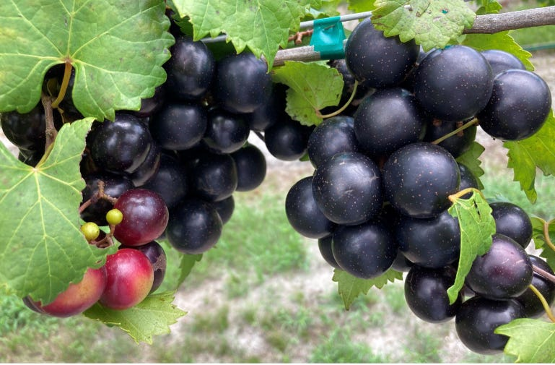
Fruit Quality
Subjective - Clean fruit free from disease and damage
Measurable - TA, Brix, pH
Subjective - Color, skin health
What’s the wine style?
Subjective - Flavor and taste

Slide 11
Pre-Harvest Sanitation
The cleaning and sanitation of processing equipment pre harvest.
Using a detergent cleaner.
Using a sanitizing solution prior to equipment use.
Food grade lubricants
When cleaning for harvest tanks, hoses, clamps, gaskets, crusher, press, crush bins.

Slide 12
Using an ATP Monitor
Wineries can use ATP testing to monitor the cleanliness of critical points in the winemaking process. This can help them to optimize their cleaning & sanitation protocols, and to prevent quality problems before they arise.
ATP (adenosine triphosphate) levels in wineries are measured using a luminometer and a testing swab:
ATP is a molecule found in all living cells, including those in bacteria and yeast. The presence of ATP on a surface indicates that it is contaminated and may not have been cleaned properly. This could mean that the surface has food residue, allergens, or bacteria on it, and could potentially support bacterial growth.
Collect a sample: Use a swab to collect a sample from a surface in the winery
Analyze the sample: Insert the swab into the luminometer
Measure the ATP level: The luminometer produces a light output that is measured in relative light units (RLU)
Interpret the results: A higher RLU reading indicates a higher amount of ATP, which means more cells are present and the surface is less clean

Slide 13
ATP Monitor
Many brands available. Average cost $ 1700.00 - $ 2500.00 per unit.
Test Swabs $ 5.00 - 12.00 each.
Average cost of wine in bottle. $ 14.50 to $ 21.00. At $ 15.00 a bottle $ 180.00 a case.
Therefore, value of product in the case $ 75.71 gallon at 50.00 % GP $ 37.85.
Value at $ 1330.00 to replace if you are fortunate. (133 gal per pallet)
Understanding that something is clean prior to sanitation is key.

Slide 14
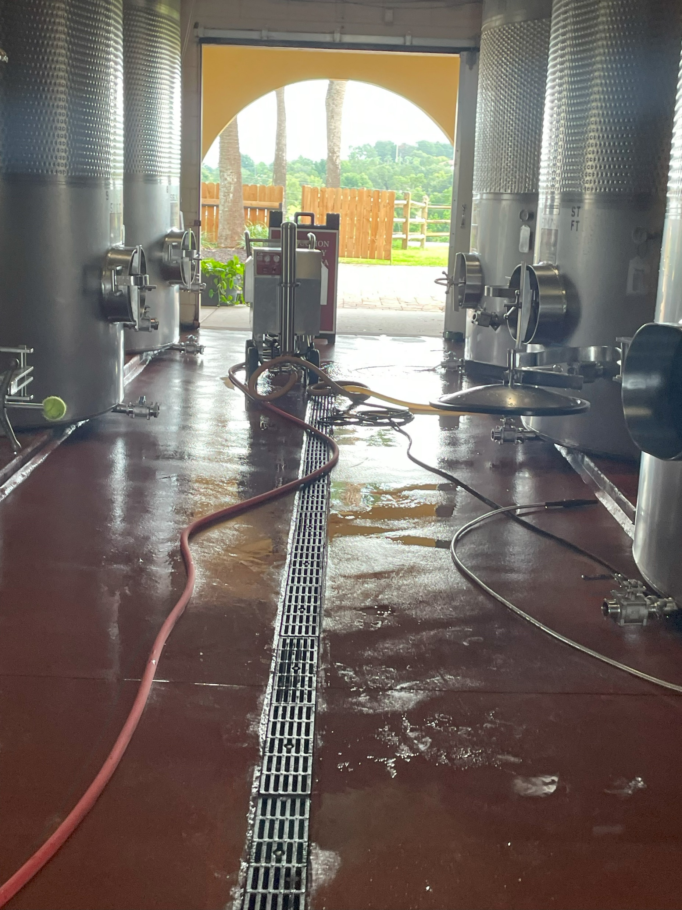
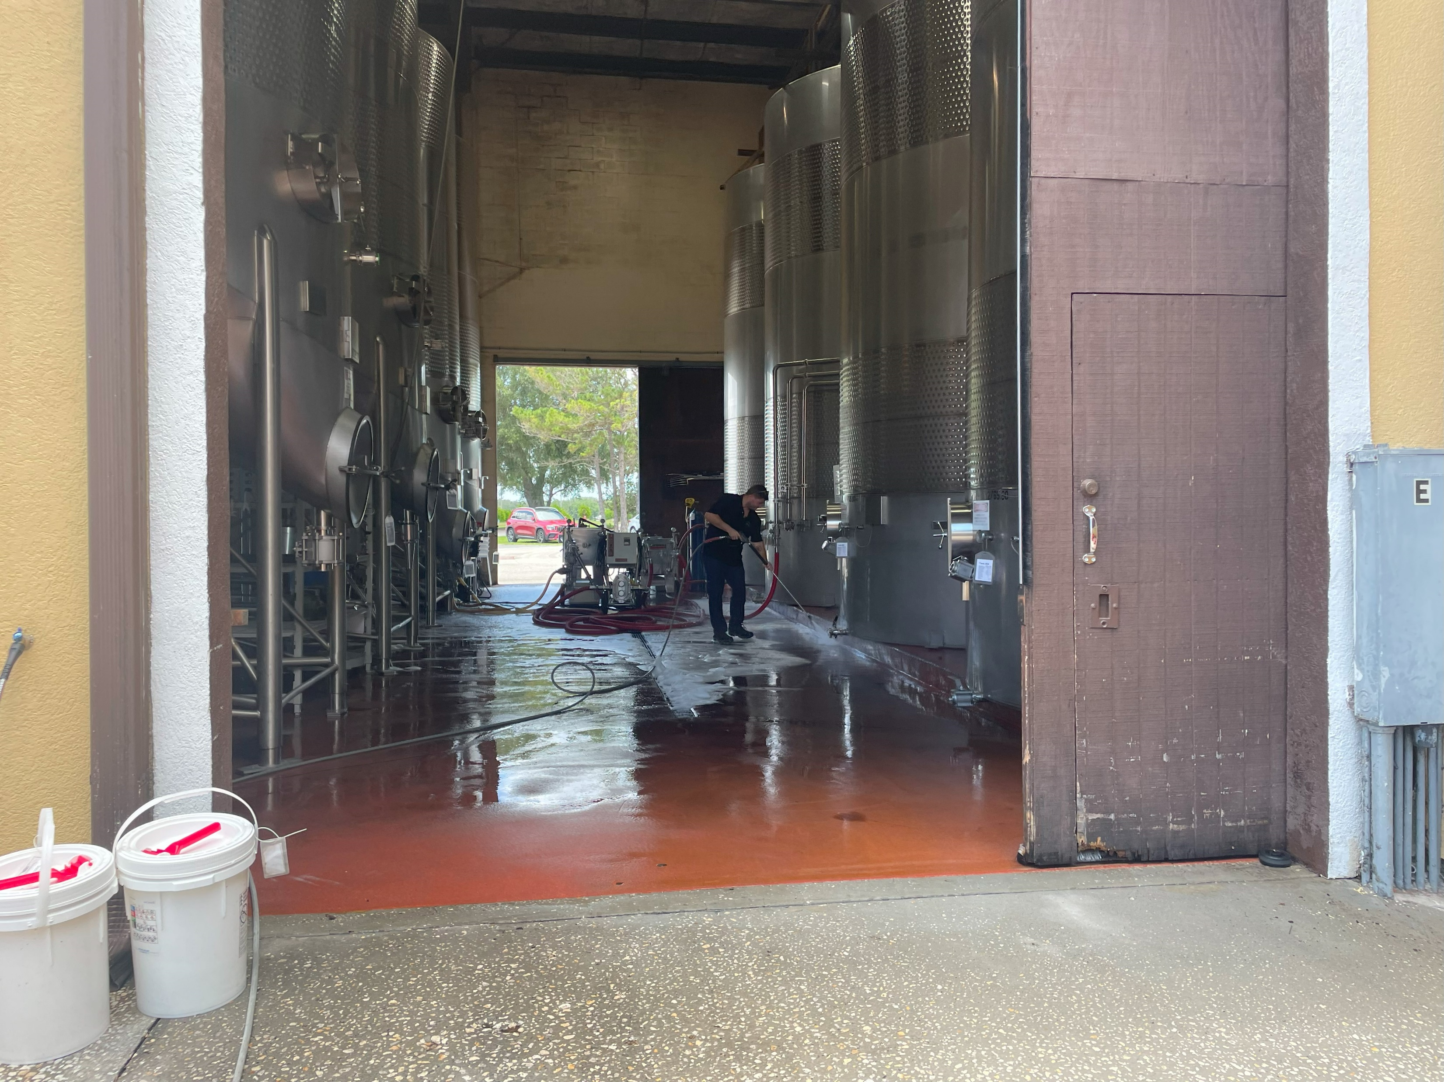
Good winemaking practice is guiding microbial populations and closing the spoilage window

Slide 15
Cleaning vs. sanitation
Winemaking is 1.00 % Science, 1.00 % Art, 1.00 % Common Sense
97.00 % Cleaning & Sanitation
Cleaning
Physical removal of organic deposits
Soil, solid particles, detritus
Sanitation
Reduction of Microbes to safe levels, kill 99.99 %
Applied post-cleaning
Sterilization
Complete destruction of all Microbes

Slide 16
Sanitation Options
Hot Water/Steam Sanitation
Inexpensive and effective
Cleaning, 100-140ºF
Sterilization, 180-200ºF for 20 min.
Sulfur Dioxide
Ozone
Quaternary Ammonia
Many choices of cleaners and sanitizers, just ensure it works on your system.

Slide 17
Fermentation Management
Clean equipment and solid juice / fruit.
Correct yeast selection, preferably one meant for wine.
Nutrient management and additions.
Appropriate brix adjustments.
Temperature control to maintain rates of fermentation.
Additions of Nutrient at 1/3 sugar depletion, make final addition before 10 brix.
Monitor Brix drops daily, adjust temperature as necessary.
With reds on skins keep the cap punched down or pumped over.

Slide 18
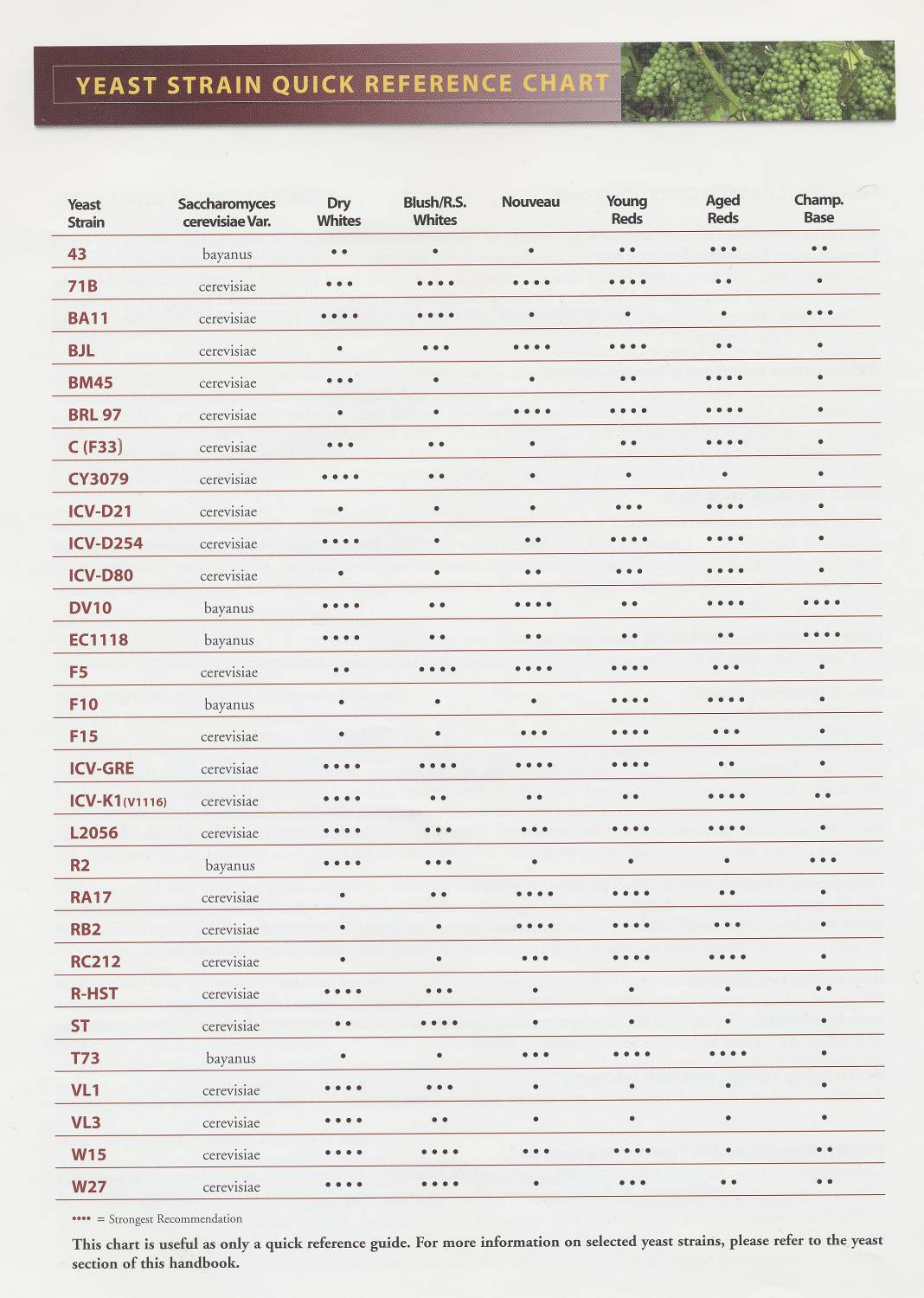
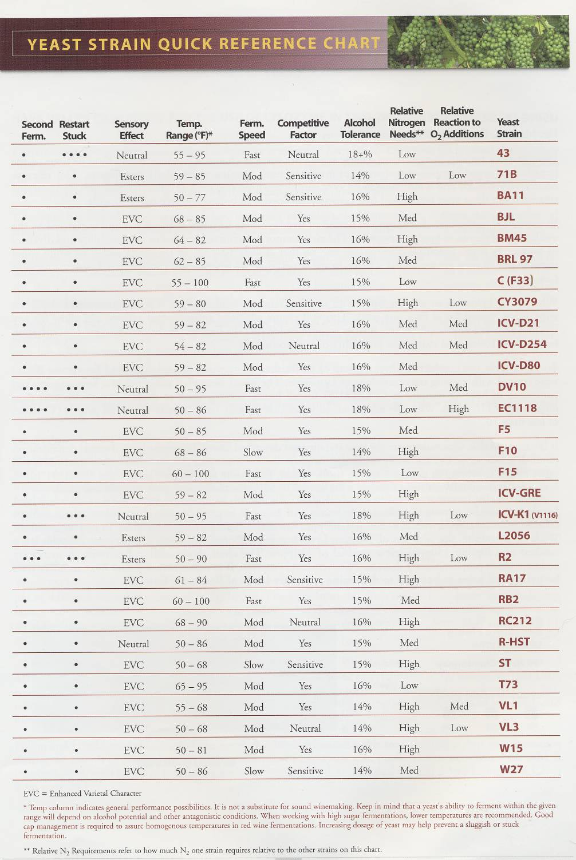

Slide 19
Blending, Filtration, Fining
Racking post ferment, clean, then clean again, sanitize.
Blending of another wine can be the difference between OKAY and great.
Fining using tannins, proteins, yeast derivatives.
The process of fining can remove unwanted phenolics, off flavors.
- drifine, albuminicol, pea protein, Clarigel, oak tannin, skin tannin, hydroclar, to name a few.
You can use tannin to change a wine style soften or add age ability to a wine.
Filtration is an important step on the evolution of a wine. Pads, lenticular, cartridge, DE filtration, centrifuge.

Slide 20
THANK YOU

